Slide 1
netlab
Making Networking Labs Suck Less
Ivan Pepelnjak (ip@ipSpace.net)
Network Architect
ipSpace.net AG

Slide 2

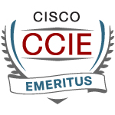

Who is Ivan Pepelnjak (@ioshints)
Past
  Kernel programmer, network OS and web developer
  Sysadmin, database admin, network engineer, CCIE
  Trainer, course developer, curriculum architect
  Team lead, CTO, business owner
Present
  Network architect, consultant, blogger, webinar and book author
Focus
  SDN and network automation
  Large-scale data centers, clouds and network virtualization
  Scalable application design
  Core IP routing/MPLS, IPv6, VPN
More @ ipSpace.net/About

Slide 3
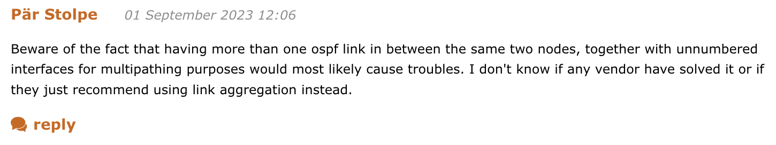

Based on a True Story
R1
R2
That should be trivial to test in a lab…

Slide 4
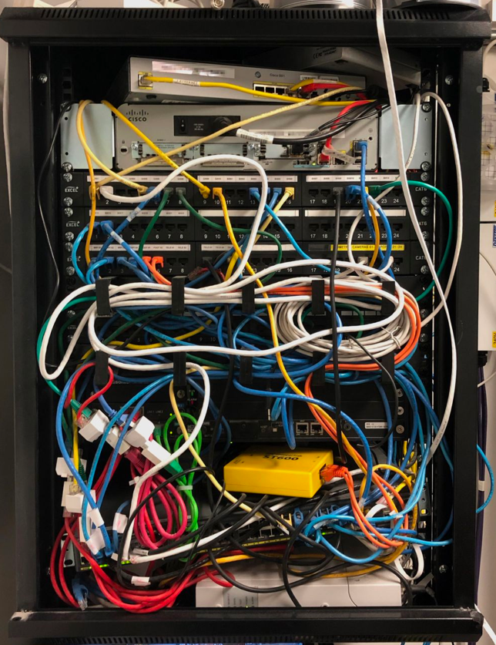
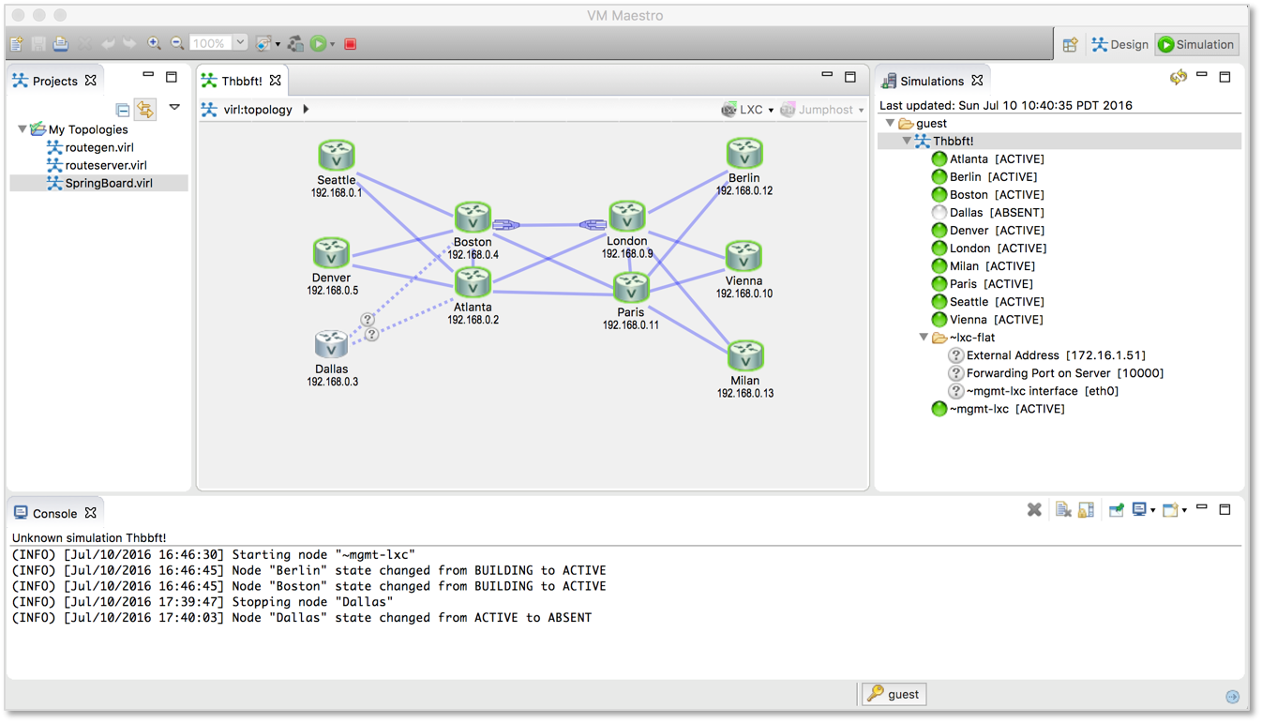
The Reality Intervenes…

Slide 5

A Networking Lab Is Much More than Topology
Build the lab topology
Create addressing plan
Deploy initial device configurations
Create virtual interfaces
Design and implement routing protocols
Add network services

Slide 6

And now for something completely different

Slide 7
What Do We Need (in Unicorn Land of Infrastructure-as-Code)
Create a high-level description of the network
  Two devices: R1 and R2
  Let’s make them Arista EOS containers
  They are running OSPF
  We need four links (two of them stub LANs)
Next
  Save the file
  Execute netlab up and you’ll get a running network
  (including IP addressing and OSPF)
R1
R2
topology.yml
nodes: [ r1, r2 ]
defaults.device: eos
provider: clab
module: [ ospf ]
links: [ r1, r2, r1-r2, r1-r2 ]

Slide 8

  Create configuration files
  Start the containers
  Start an Ansible playbook
  Initial device configuration
  Configuring OSPF
  Connect to the device
  … and we have the answer!

Slide 9


Wait, What Just Happened?
netlab
create
Topology file
Plugins
Modules
Defaults
CLI arguments
Data model transformation
Snapshot
Orchestrator configuration
Ansible inventory
Prepare virtual infrastructure
Start the lab
Adjust networking infrastructure
netlab
initial
Custom configuration templates
System configuration templates
Ansible playbook

Slide 10
Building a Networking Lab with netlab
Build the lab topology
Initial netlab use case
Create addressing plan
Built-in and custom IPv4 + IPv6 address pools
(loopback, P2P, LAN, VLAN, VNI, tunnels)
Deploy initial device configurations
Jinja2 configuration templates + Ansible plays
for 20+ platforms
Create virtual interfaces
VLAN, VRF and VXLAN configuration modules
Design and implement routing protocols
OSPF, IS-IS, EIGRP, BGP, MPLS configuration modules
Add network services
EVPN, MPLS/VPN, 6PE configuration modules

Slide 11
Every Lab Is Special
Build the lab topology
Add custom configuration
  Static configuration templates
  Configuration templates modifying built-in configurations
  Multi-vendor and multi-platform support
Modify data transformation with plugins
  Modify the built-in transformation rules
  Add new functionality
  (example: IP anycast)
  Add new attributes or functionality to existing configuration modules (example: BGP allowas-in)
Create addressing plan
Deploy initial device configurations
Create virtual interfaces
Design and implement routing protocols
Add network services

Slide 12
Current State of netlab (September 2023)
Platforms
  Arista EOS
  Aruba CX
  Cisco ASAv, IOSv, IOS XE (CSR), Nexus OS (9300v), IOS XR
  Cumulus Linux 4.x and 5.0 (NVUE)
  Dell OS10
  Fortinet
  FRR
  Generic Linux host or container
  Juniper vSRX 3.0, vMX, vPTX (vEVO)
  Mikrotik RouterOS 6 and 7
  Nokia SR Linux and SR OS
  VyOS 1.4
Virtualization providers
  KVM with libvirt (Vagrant)
  VirtualBox (Vagrant)
  Docker (containerlab)
  Hardware labs (requires extra interface information)
Multi-provider topologies
  Combine containers and virtual machines in the same lab
  Connect external devices with the virtual lab

Slide 13
Current State of netlab (September 2023)
Addressing
  IPv4 + IPv6
  Address pools + static prefixes
  VLAN-wide subnets
  Static interface addresses
  Unnumbered IPv4 and IPv6 (LLA) interfaces
  Layer-2-only interfaces
Data Plane
  VLANs
  VRFs
  VXLAN (static ingress replication or EVPN)
  MPLS including SR-MPLS
  SRv6
  Tunnel interfaces
Routing Protocols
  OSPFv2 and OSPFv3
  IS-IS
  EIGRP
  BGP
  BFD
  VRRP and anycast gateways
MPLS Control Plane
  LDP, BGP-LU, SR-MPLS (OSPF or IS-IS)
Network Virtualization
  MPLS L3VPN and 6PE
  EVPN (bridging, VLAN bundles, asymmetric and symmetric IRB)

Slide 14
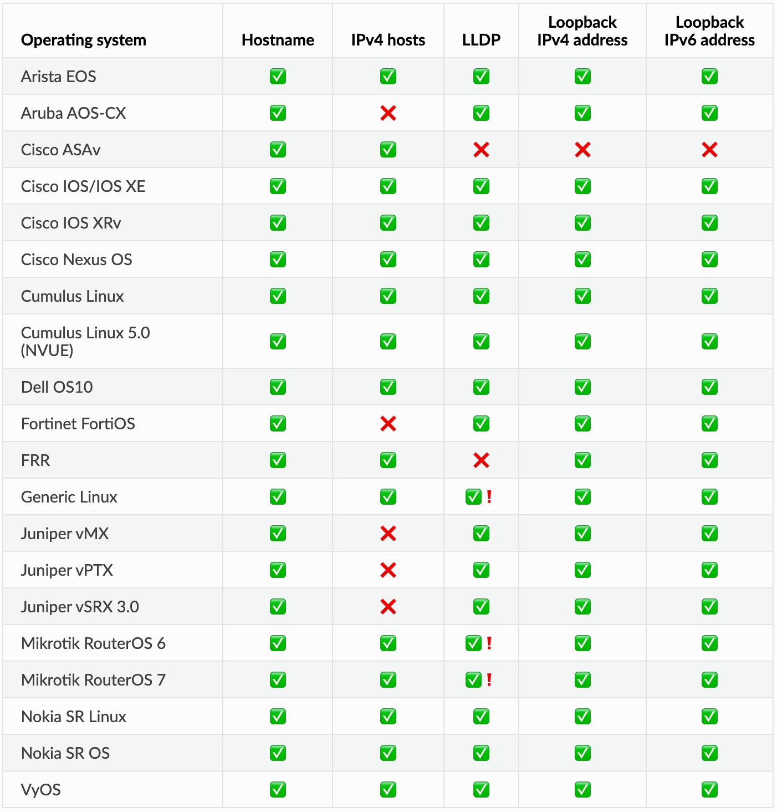
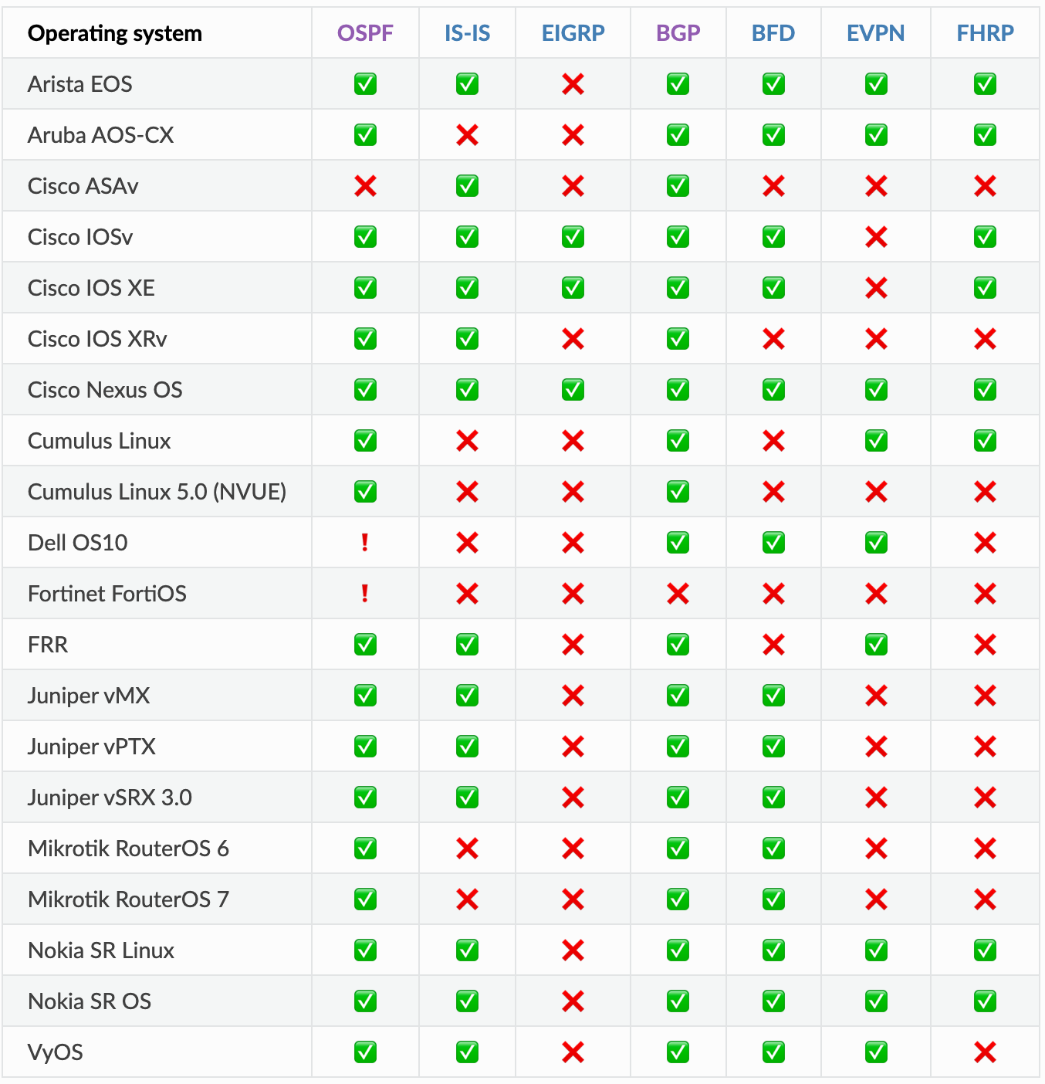
Sample Platform Support
More @ https://netlab.tools/platforms/

Slide 15
But Wait, There’s More
External Connectivity
  Macvtap libvirt interfaces
  Macvlan container interfaces
  Port forwarding for VMs and containers
External Tools
  SuzieQ
  Graphite
Ease-of-use
  Reports (text, Markdown, HTML)
  Graphs (Graphviz or D2)
  GUI 🎉 🎉 🎉
  Multiple lab instances on a single server
Large topologies
  Topology templates
  Staggered device start
  Link groups

Slide 16
Deployment Scenarios

Slide 17
VirtualBox Architecture
MacOS or Windows
Prerequisite software
  Python3
  VirtualBox
  Vagrant
  Ansible
netlab CLI
Vagrant
Ansible
VirtualBox

Slide 18
KVM + libvirt Architecture
Linux (Ubuntu)
Prerequisite software
  Python3
  Ansible
Virtual machines
  KVM+libvirt
  Vagrant
  vagrant-libvirt plugin
Containers
  Docker
  Containerlab
netlab CLI
Vagrant
libvirt
Ansible
KVM
Linux bridge

Slide 19
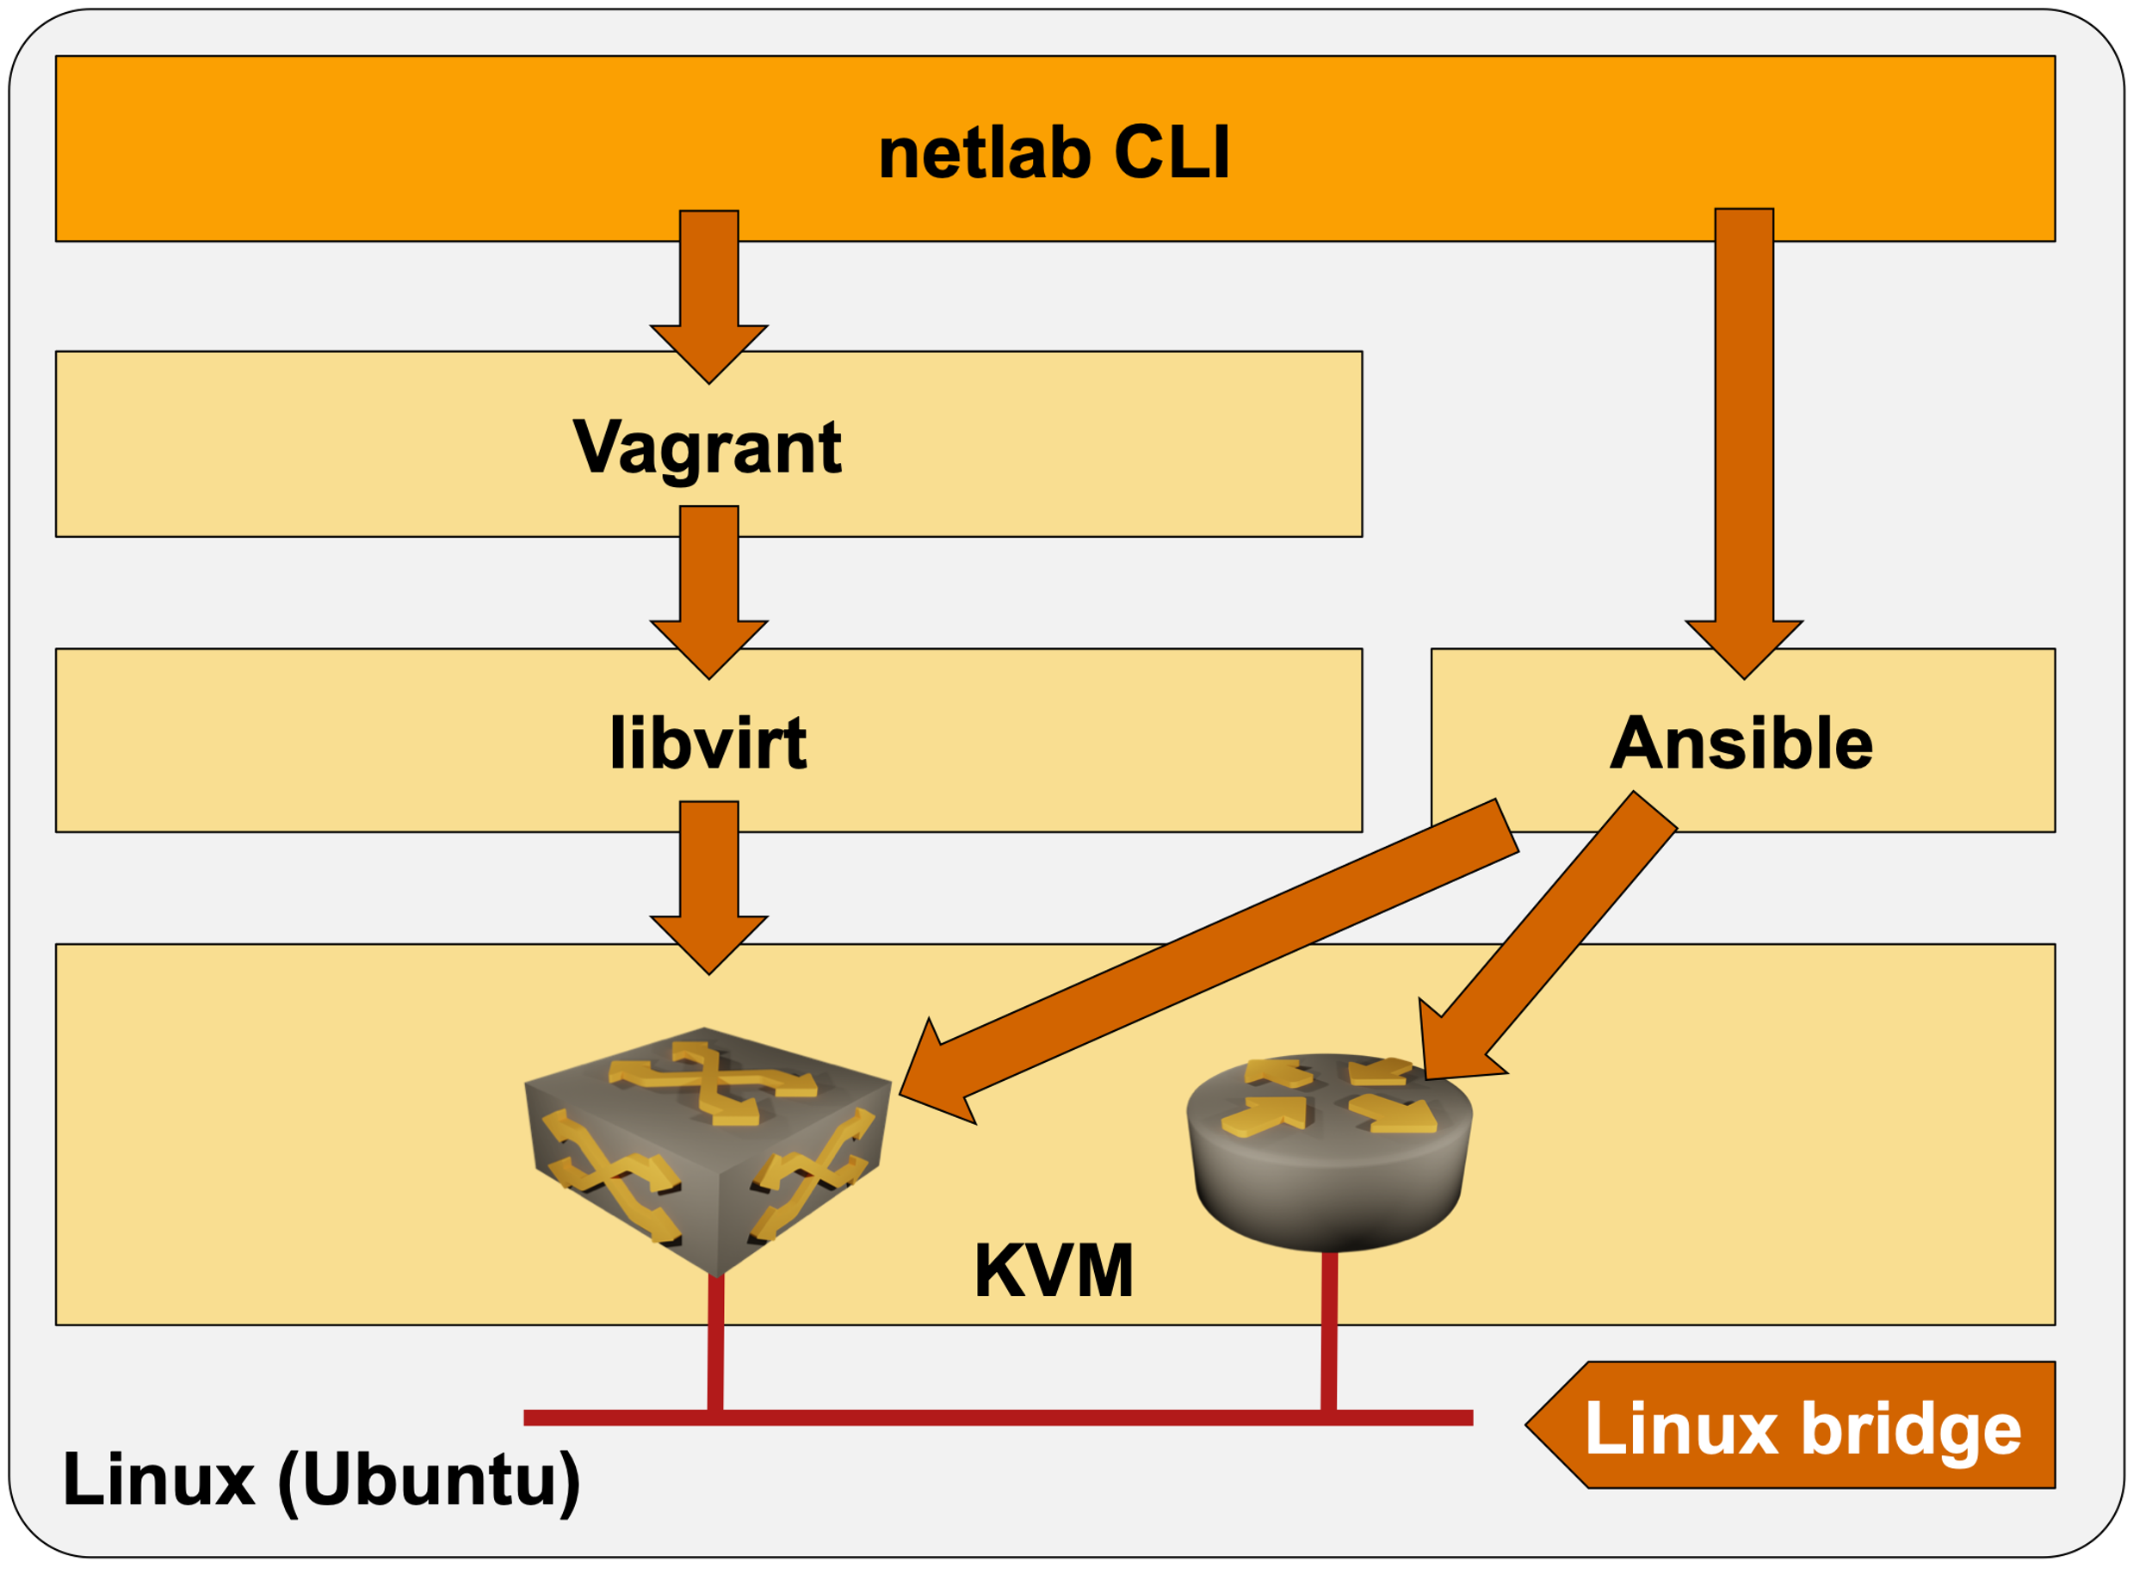
Ubuntu VM on MacOS or Windows
MacOS or Windows
Virtualization solution with nested virtualization
  VirtualBox
  VMware Workstation/Fusion
Optional
  Vagrant (simplifies the operations)
Alternative
  Cloud deployment
Vagrant
VirtualBox or VMware Workstation/Fusion

Slide 20

Some Assembly Required (Thank You, Vendors)
Automatically downloadable images and containers
  FRR
  Cumulus Linux
  Nokia SR Linux
Easy to download
  New Juniper virtual machines
Most everything else (from bad to worse)
  Registration
  Download tied to a valid support contract
  Begging your SE
  Available only if you know someone

Slide 21
But Wait, That’s Not All
After you download a container image
  Unpack and install it (easy)
Virtual machines are a nightmare
  Download a virtual disk
  It boots without a configuration and expects stuff on serial port
  Exception: Junos and ASA can take configuration from a mounted
  CD-ROM
Building a Vagrant box
  What we need to automate lab startup
  Start the VM, answer a dozen questions
  Copy-paste initial configuration
  Save the configuration, shut down the VM
  Package as a Vagrant box, hope it works

Slide 22
Getting Started

Slide 23
Getting Started with netlab
Get decent hardware
  Network devices consume between 256K (Mikrotik) and 8GB (IOS XRv, Juniper vPTX) per node
Decide which deployment architecture you want to use
  Existing hardware using Windows/Mac: Ubuntu VM (VMware desktop virtualization works well)
  Standalone Linux server on dedicated hardware
Installation
  Install Python3 if needed
  Install networklab package with pip
  Use netlab installation scripts to install libvirt/KVM, Vagrant, Ansible, Docker, containerlab…
  Download or build Vagrant boxes
Support
  Github issues, network2code Slack channel

Slide 24

Questions?
Netlab resources
Documentation: netlab.tools (see also: More Information section)
Blog posts: blog.ipspace.net/tag/netlab.html
Source code: github.com/ipspace/netlab
Examples: github.com/ipspace/netlab-example
Sample labs: ipspace.github.io/bgplab/
To reach me
Web: ipSpace.net
Email: ip@ipSpace.net

Slide 25
netlab High Level Architecture

Slide 26
High-Level Architecture
Topology file
Plugins
System defaults
netlab CLI
Vagrant
Containerlab
Ansible
VirtualBox
libvirt
Docker
KVM

Slide 27
Data Transformation and Configuration File Creation
Topology file
Plugins
Modules
Defaults
CLI arguments
Data model transformation
Snapshot
Orchestrator configuration
Ansible inventory
External tool configurations

Slide 28
netlab initial – Device Configurations
Ansible inventory
Custom configuration templates
System configuration templates
Ansible playbook
Device-specific configuration
Module-specific configuration
Module-specific task list

